Slide 1

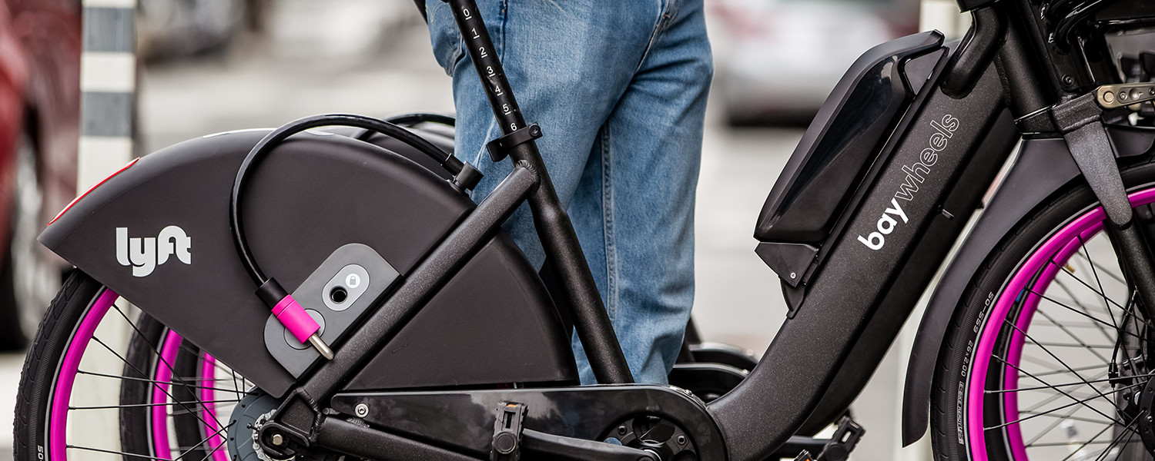
Project V1
Sanket Patel
100800990

Slide 2
Background Overview
^{[1]}Bay Wheels is a regional public bicycle sharing system in California's San Francisco Bay Area. It is operated by Motivate in a partnership with the Metropolitan Transportation Commission and the Bay Area Air Quality Management District. Bay Wheels is the first regional and large-scale bicycle sharing system deployed in California and on the West Coast of the United States. It was established as Bay Area Bike Share in August 2013. As of January 2018, the Bay Wheels system had over 2,600 bicycles in 262 stations across San Francisco, East Bay and San Jose.
In June 2017 the system was officially re-launched as Ford GoBike in a partnership with Ford Motor Company. After Motivate's acquisition by Lyft, the system was renamed to Bay Wheels in June 2019. The system is expected to expand to 7,000 bicycles around 540 stations in San Francisco, Oakland, Berkeley, Emeryville, and San Jose.
^{[2]}Research and experience tell us that there can be problems with bike sharing. For example, although the usage rate of these schemes tends to vary globally between three and eight trips per bicycle per day, some facilitate as few as 0.3 trips per bicycle per day.
Despite these difficulties, bike sharing schemes are, on the whole, a win for everyone. Cities are able to enhance their image and civilians from all socio-economic classes would benefit from cleaner roads and clearer air and quicker commutes in traffic congested areas.

Slide 3
Problem Statement
Explore the usage of bike sharing system in the city of San Francisco and explain how can we increase the usage and promote this mode of transportation mode.
What are the overall focus areas to increase our current system usages?
If we were to run a marketing campaign, what are the key focus areas for our campaign?

Slide 4
Business questions
How can we increase average trip duration?
How can we increase total number of trips?
Who is our core customer? Which demographic represents them?
Knowing our customer, how can we potentially target our marketing campaign?
How can we optimize operating costs?

Slide 5
Data analysis Questions:
Below are the questions that could be asked :
What are the Stations with high usage rate.
What is the average trip duration.
Who are the users with high trip duration.
What is the Age Group of users with high usage.
Stations with high Registered users.
Start Station Name with high Trip Duration.
User Types with high Trip Duration.
Popular areas using Station Lat/Long.
Average Age Group of users.
Season with high users.

Slide 6
Tools and methodology
Methodology^{[3]}
Step 1 — Be clear on the questions.
Step 2 — Know data and start with basic visualizations.
Step 3 — Identify messages of the visualization and generate the most informative indicator.
Step 4 — Choose the right chart types.
Step 5 — Use color, size, scale, shapes and labels to direct attention to the key messages.
Data source
Google Big query (public dataset): Dataset Link
Contains 4 tables:
bikeshare_regions (Region Level table)
bikeshare_station_info (Station level table)
bikeshare_station_status (Status of stations for bike mapping)
bikeshare_trips (Individual Trip Level)
Tools
-Tableau 2019.4
-Matplotlib
-Seaborn

Slide 7
References
Bay Wheels. (2020). Retrieved 25 October 2020, from https://en.wikipedia.org/wiki/Bay_Wheels
The global bike sharing boom – why cities love a cycling scheme. (2020). Retrieved 25 October 2020, from https://theconversation.com/the-global-bike-sharing-boom-why-cities-love-a-cycling-scheme-53895#:~:text=The%20benefits%20of%20bike%20sharing%20schemes%20include%20transport%20flexibility%2C%20reductions,is%20the%20idea%20of%20sharing
A 5-step guide to data visualization. (2020). Retrieved 25 October 2020, from https://www.elsevier.com/connect/a-5-step-guide-to-data-visualization

Slide 8
Thank you

